Slide 1

TEAM NO : 26
TITLE : FPGA IMPLEMENTATION OF AES ALGORITHM
Students Details :
Guide : Prof. Rajeshwari M.
S.NO. | NAME | USN
1 | Hema M Basaligundi | 01FE22BEC291
2 | Haripriya G | 01FE22BEC295
3 | Manupriya P. | 01FE22BEC303
4 | Ganga I Aralikatti. | 01FE22BEC306

Slide 2
CONTENTS :
Introduction
Literature Survey
Methodology
Conclusion

Slide 3
HISTORY
An older cryptography algorithm was the Data Encryption Standard (DES).
For security products, DES algorithm was widely used. Such that from the year 1977, the Data Encryption Standard has been used as the standard algorithm however, just because of the very small key size of only 56 bits, it can be easily hacked and cracked. Because of this reason,in September 1997 an institute known as the National Institute of Standards and Technology (NIST) announced for new different algorithms.
In 1998,15 AES algorithms were declared as security alhorithms.
At last, on 2 October, 2000, the Rijndael algorithm (Dr.Joan Damen,Dr.Vincent Rijmen)was selected, that was announced by the NIST.
In November 2001, the NIST declared the Advanced Encryption Standard (AES) [02] algorithm as the perfect security algorithm replacing the DES algorithm.

Slide 4
INTRODUCTION
AES (Advanced Encryption Standard)
An AES is the most popular security algorithm and it is required to improve the performance of AES with increasing the demand of internet security.
AES is a symmetric key algorithm in which only one key is requires for encryption and decryption process, key must be same.
It is developed by the National Institute of Standards and Technology (NIST) in 2001.
AES encryption uses various key lengths (128, 192, or 256 bits) to provide strong protection against unauthorized access.
This data security measure is efficient and widely implemented in securing internet communication, protecting sensitive data, and encrypting files.
AES is a Block Cipher since AES performs operations on bytes of data rather than in bits.

Slide 5
The first process is encryption which converts the original plain text into secured text which is called as cipher text.
The second process is decryption, which converts this cipher text again into the original text. Cryptography algorithm is mainly divided into two forms; one is Symmetric cryptography and second is Asymmetric cryptography.
In Symmetric key cryptography only one key is used for both process encryption and decryption which must be same so, it is also called secret key cryptography, but in case of Asymmetric cryptography two different keys are used for both the processes so that it is also called private key cryptography.
Symmetric key algorithms are more preferable than asymmetric key algorithms because execution time of asymmetric algorithm is slower than symmetric key algorithm.

Slide 6
Working of AES Algorithm:
AES algorithm takes 128 bits as input and outputs 128 bits of encrypted cipher text.
AES relies on the substitution-permutation network principle, which is performed using a series of linked operations that involve replacing and shuffling the input data.
AES performs operations on bytes of data rather than in bits. Since the block size is 128 bits, the cipher processes 128 bits (or 16 bytes) of the input data at a time.
The number of rounds depends on the key length
Number of Rounds | Key Size(in bits)
10 | 128
12 | 192
14 | 256

Slide 7
State Array : AES works on an array of bytes of a 4x4 matrix, which is known as state.
Each byte consists of 8 bits, making a total of 16 bytes for 128 bits.
The plaintext is stored in a 16-byte state array (128 bits).
All transformations of encryption process are performed only on a state. After each transformation values are stored in a state, this state is the input for the next transformation.
Transformation Process
Initial Transformation : The input state undergoes an initial transformation.
Rounds : The transformed state is processed through multiple rounds (n rounds).
Each round consists of four transformations (except the last round, which has three).
Round Transformations
Substitute Bytes : Substitutes bytes in the state array using a substitution box (S-box).
Shift Rows : Shifts the rows of the state array.
Mix Columns : Mixes the data within each column of the state array.
Add Round Key : Combines the state with a round key derived from the original key.

Slide 8
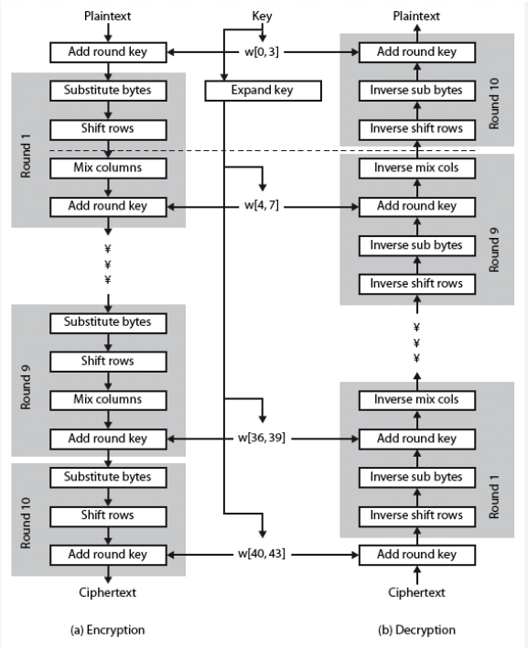
Rounds : The number of rounds (n) varies based on the key size:
128 bits : 10 rounds
192 bits : 12 rounds
256 bits : 14 rounds

Slide 9
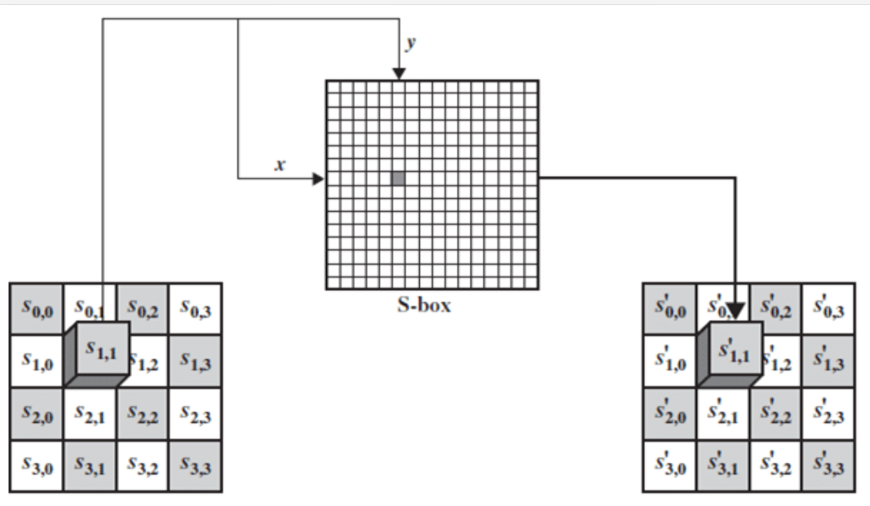
1.Substitute-bytes

Slide 10
Key Scheduling
Round Keys : Each round requires a specific round key, generated from the original key using a key scheduling algorithm.
Key Sizes : Original key sizes can be 128, 192, or 256 bits.
All round keys are 128 bits in size.
AES Variants
AES-128 :
Key Size: 128 bits
Rounds: 10 (9 rounds with 4 transformations, 1 round with 3 transformations)
AES-192 :
Key Size: 192 bits
Rounds: 12 (11 rounds with 4 transformations, 1 round with 3 transformations)
AES-256 :
Key Size: 256 bits
Rounds: 14 (13 rounds with 4 transformations, 1 round with 3 transformations)

Slide 11
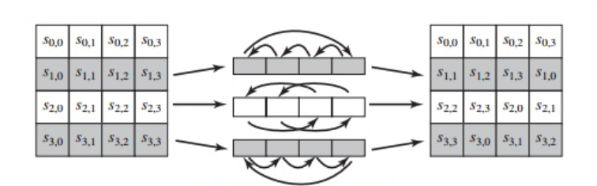
A lookup table (S-Box) is used.
Each byte in the state array is replaced by a corresponding value from the S-Box.
Example: If the input is s00, it is replaced by S[0][0].
2.Shift rows

Slide 12
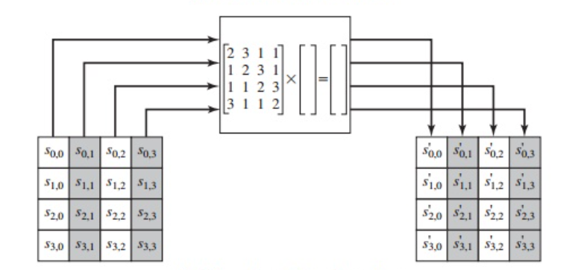
Rows of the state array are shifted:
First Row: No shift.
Second Row: Shifted left by 1 byte.
Third Row: Shifted left by 2 bytes.
Fourth Row: Shifted left by 3 bytes.
This operation alters the order of bytes in the rows.
3.Mix-columns

Slide 13
A matrix multiplication is performed using a predefined 4x4 matrix.
Each column of the state array is mixed to produce new values.
The output remains a 4x4 matrix.
4.Add Round Key
A simple XOR operation is performed between the state array and the round key.
The round key is derived from the key scheduling algorithm.
Each column of the state matrix is XORed with the corresponding column of the round key.

Slide 14
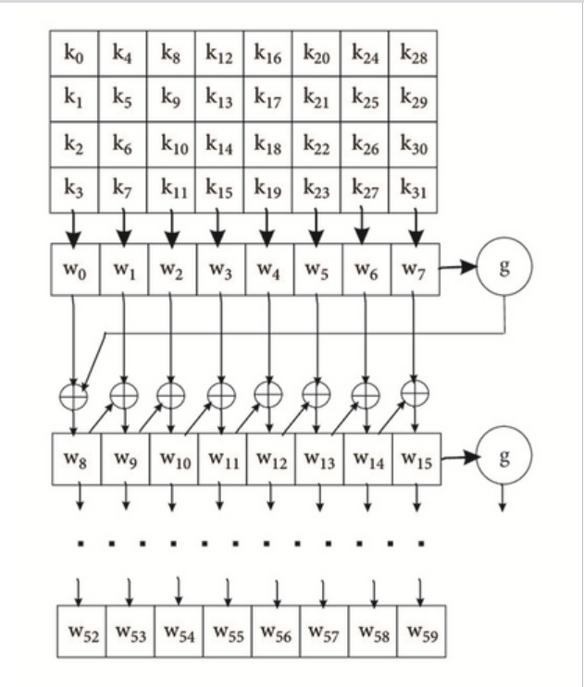

Slide 15
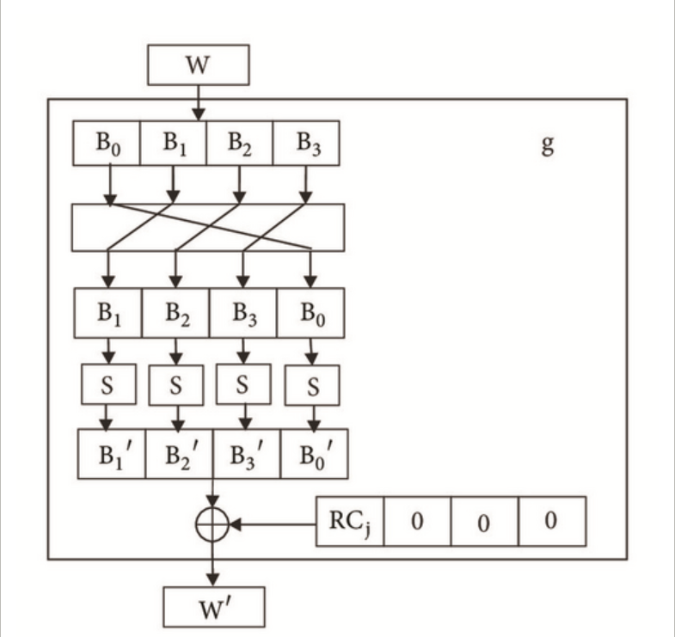

Slide 16
LITERARUTRE SURVEY
Implementation of AES Algorithm on FPGA and on software-2020,2020 IEEE International Conference for Innovation in Technology (INOCON) Bengaluru, India
Aim: In this they have done a comparison between software implementation of AES algorithm and FPGA implementation of AES Algorithm.
Implementation:On ARTIX-7 FPGA.
Why hardware implemntation:
Software encryption is quite cheap and easy to implement it is not as fast as implemented on hardware as many factors influence the speed (speed of compiler, operating system, firmware, processor speed etc.)
Since in FPGA a separate dedicated processor can be configured, it is much faster than software encryption.
In hardware encryption on the other hand, the above factors won’t come into picture and the speed purely depends on hardware components which is generally fast. This makes hardware encryption faster.

Slide 17
FPGA Implementation of AES Algorithm - 2017 IEEE Conference
Aim:developing a synthesizable VHDL code for AES while ensuring optimized hardware resource utilization.
This paper discusses the implementation of the Advanced Encryption Standard (AES) algorithm on Field Programmable Gate Arrays (FPGA) using VHDL (Very High-Speed Integrated Circuit Hardware Description Language). The study focuses on:
- Efficient FPGA implementation of AES encryption and decryption.
- Minimizing hardware consumption using an iterative design approach.
- Simulation and optimization of AES using Xilinx ISE tools.
- Performance analysis of FPGA-based AES encryption and decryption.
Work:
* AES Algorithm and Its Importance
*AES Implementation on FPGA
*Hardware Performance Metrics
Implementation:
* Xilinx ISE 9.2 Software.
*The FPGA used is Xilinx Virtex Family (XCV600).

Slide 18
Implementation & Results
The proposed AES design was implemented in Xilinx ISE 9.2and tested on a Xilinx Virtex Family (XCV600) FPGA.
Key Performance Metrics:
| Parameter | Value |
| AES Block Size | 128-bit |
| Key Length| 128-bit |
| Number of Rounds | 10 |
| Throughput| 352 Mbps |
| Clock Frequency | 140.39 MHz |
| Total Clock Cycles per Encryption | 51 |
*Minimal Hardware Usage: Due to the iterative approach.
*Efficient Memory Utilization:Dynamic key expansion reduces memory footprint.
*High Throughput:352 Mbps, suitable for real-time encryption applications.

Slide 19
Conclusion:
- This paper successfully implements AES on FPGA using an optimized iterative approach.
- The proposed method minimizes hardware consumption while maintaining high encryption speed.
- The use of dynamic key expansion further reduces memory usage.
- Performance analysis shows that the proposed design achieves 352 Mbps throughput while keeping FPGA resource utilization low.
- The design is scalable, allowing easy adaptation to AES-192 and AES-256.
Gaps:
-Limited FPGA operartion-Many AES FPGA designs do not optimize speed and power efficiency which will lead to trade-off.

Slide 20
Proposed solutions:
*Balanced Performance Optimization-Avoiding unnecessary duplication of logic circuits.
- Optimizing clock cycle usage to achieve high-speed encryption.
*Works efficiently on resource-limited FPGA devices.
Future Improvements:
➡ Implement pipeline architecture to further increase throughput.
➡ Extend the design for AES-192 and AES-256 for enhanced security.
➡ Optimize power consumption for battery-powered FPGA devices.

Slide 21
FPGA Implementation of Dual Key Based AES Encryption with Key Based S-Box Generation-
IEEE-2015 2nd International Conference on Computing for Sustainable Global Development (INDIACom).
1.Aim:The primary goal is to increase security without significantly compromising performance by reducing vulnerability to cryptanalysis and optimizing FPGA resource usage.
2.Research:
A. Vulnerabilities in Conventional AES
- Static S-Box Issues:
- Traditional AES uses a predefined S-Box(stored as a look-up table).
- This consumes excessive memory and is vulnerable to cryptanalysis (e.g., differential attacks, algebraic attacks, reverse engineering).
- Single Key Encryption Weakness:
- The security of AES depends entirely on a single key.
- If the key is compromised, the entire encryption is broken.

Slide 22
B. Prior Research and Its Shortcomings
1. Dynamic S-Box Approaches
- Some prior works proposed dynamic S-Box generation to avoid the weaknesses of look-up tables.
- However, many of these introduce high computational complexity, making FPGA implementation difficult.
2.Dual-Key AES Proposals
- Some researchers suggested modifying AES to use two keys, but their approaches included unnecessary transformations(e.g., key-based shift rows and columns) that did not significantly enhance security.
C. Proposed Enhancements in This Paper
- The authors remove unnecessary transformations and instead introduce:
- Key-Based S-Box Generation (reducing predictability).
- Dual-Key Encryption Scheme (increasing resistance to cryptanalysis).
- Optimized FPGA Implementation for better performance vs. security trade-off.

Slide 23
3. Implementation & Results:
The proposed Dual-Key AES was implemented on an Actel SmartFusion FPGA and compared to traditional AES.
Performance Metrics:
| Parameter |Traditional AES | Dual-Key AES |
| Combinational Delay (ns) | 15.37 ns | 23.65 ns |
| Logic Slices Used | 5% | 6% |
| Clock Cycles per Encryption | 10 | 10 |
*Security Improvement:Brute force time increased by a factor of 38.
*Marginal Resource Increase:1.2x more logic slices used, but significantly higher security.

Slide 24
4.Gaps:
*Single Key Encryption is a Weakness.
* Static S-Box Makes AES Vulnerable to Attacks.
* Previous AES Modifications Were Inefficient.
Proposed solution for the gaps:
*Dual-Key Encryption Scheme.
*Key-Based S-Box Generation.
*Optimized FPGA Implementation.

Slide 25
5.Conclusion
- The paper successfully enhances AES security while keeping FPGA resource utilization low.
- The key-based S-Box removes static vulnerabilities without excessive computational overhead.
- Dual-Key Mechanism makes cryptanalysis significantly harder without drastic performance reduction.
- FPGA Implementation Results:
- Marginally increased delay (23.65 ns vs. 15.37 ns).
- Only 1% increase in logic slices.
- Major security improvement (brute force complexity ×38).
*The proposed approach balances security and efficiency well.
*Highly recommended for FPGA-based security applications where *enhanced AES encryption is needed.

Slide 26
Title:FPGA implementation of AES
1.Aim : The aim is to improve the performance of the Advanced Encryption Standard (AES) algorithm by implementing it on Field Programmable Gate Arrays (FPGAs). The focus is on achieving higher speed, better flexibility, and reduced hardware complexity compared to software-based implementations.
2.Methodology :
Encryption Standard: Uses the AES algorithm with a 128-bit block size and 128-bit key size.
FPGA Implementation: The AES encryption algorithm is implemented using VHDL (VHSIC Hardware Description Language) and simulated on Xilinx ISE 14.4.
Design Approach: A repetitive looping method is used to improve performance.
Hardware Platform: Implementation is tested on Xilinx Spartan-6 (XC6SLX45) and Virtex-5 (XC5VFX130) FPGA chips.
Key Operations in AES Encryption:
SubBytes Transformation: Byte substitution using an S-Box.
ShiftRows Transformation: Cyclic shift of rows for data diffusion.
MixColumns Transformation: Polynomial multiplication for mixing data.
AddRoundKey Transformation: XOR operation with the expanded key.
Key Expansion: A Key Expansion Algorithm generates a series of round keys from the initial encryption key.

Slide 27
3.Conclusion :
The FPGA-based AES implementation achieves higher frequency and better hardware efficiency compared to previous works. The hardware complexity is reduced, requiring fewer slice registers and LUTs (Look-Up Tables).The implementation achieves better throughput and area efficiency compared to prior designs.
4.Gaps:
Limited Key Size Implementation: Focuses only on AES-128, whereas AES-192 and AES-256 could provide higher security.
No Power Consumption Analysis: While speed and hardware utilization are analyzed, power consumption is not evaluated, which is crucial for real-world applications.
Comparison with Other FPGA Platforms: Limited to Xilinx Spartan-6 and Virtex-5 FPGAs. Comparison with modern FPGAs like Virtex-7 could provide more insights.

Slide 28
Title: An Efficient Implementation of AES algorithm using Custom Key
1.Aim:
To design an optimized AES hardware system with dual key sizes (128-bit & 256-bit), enhancing security and reducing area, delay, and power consumption.
2.Methodology:
Dual Key Encryption: Introduced a second random 128-bit key for initial XOR operation before encryption to increase security.
Modified SubByte Operation: Bytes in the state matrix are swapped before S-box substitution, making decryption harder for attackers.
Compact MixColumn & Inverse-MixColumn: Used only XOR operations , reducing hardware resource usage.
Iterative Encryption/Decryption Core: Designed an optimized structure to reduce area and delay.
Hardware Implementation: Developed in Verilog and tested using ModelSim-Altera 6.3g_p1 (Quartus II 8.1).
Performance Evaluation: Compared area, power consumption, and delay with conventional AES implementations.

Slide 29
3.Conclusion
The proposed AES design reduces area by 21.27%, delay by 16.99%, and power consumption by 3.99% compared to conventional AES implementations.
The modified algorithm enhances security by adding an additional key and altering the SubByte operation to counter side-channel attacks.
The iterative approach ensures reduced computation time while maintaining cryptographic strength.
4.Gaps & Future Scope
Security Testing: Further validation using different attack models and cryptanalysis techniques is needed.
Alternative Data Types: Future research can explore applying the modified AES algorithm to images, audio, and video encryption.
Machine Learning Integration: A potential research avenue includes using ML models to classify secure vs. Trojan-injected AES implementations.

Slide 30
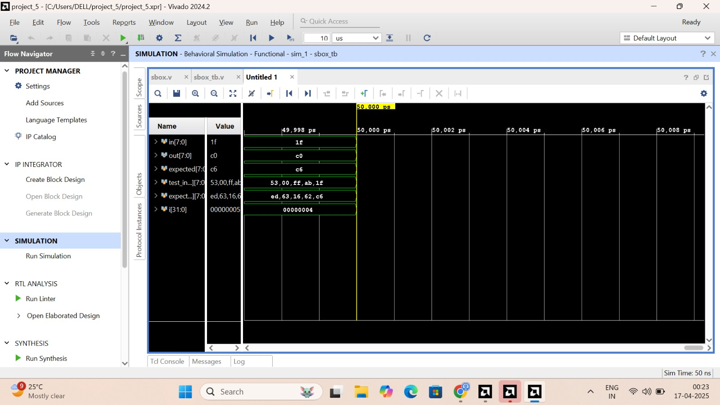
Simulation of Sbox Substitution

Slide 31
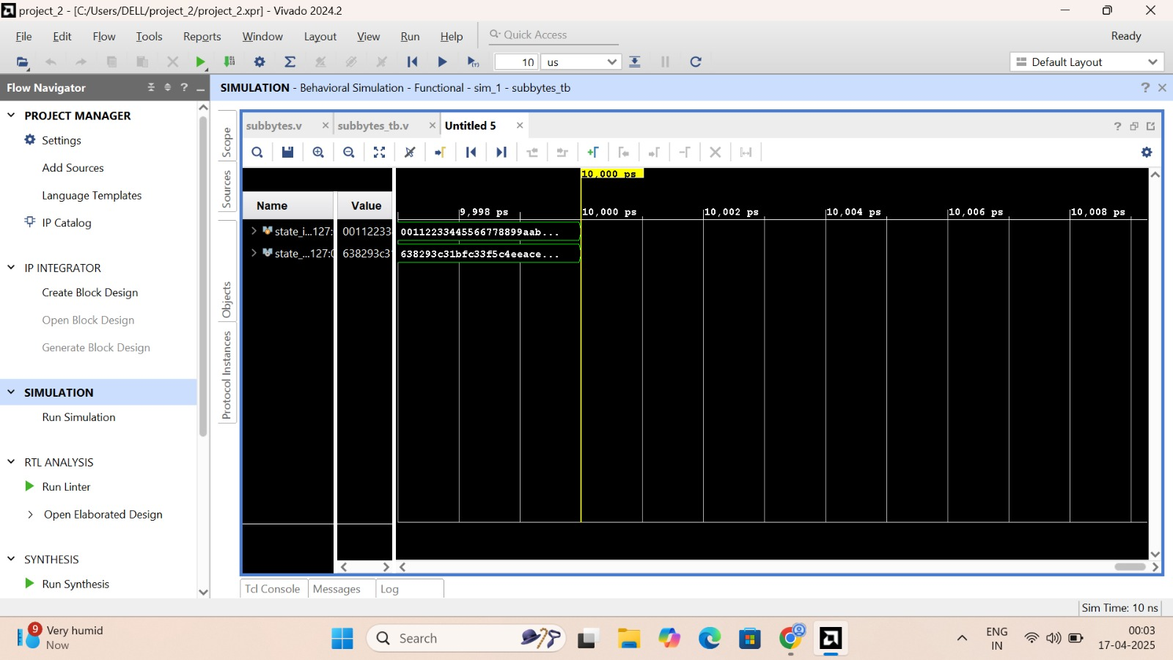
Simulation of Subbyte Transformation

Slide 32
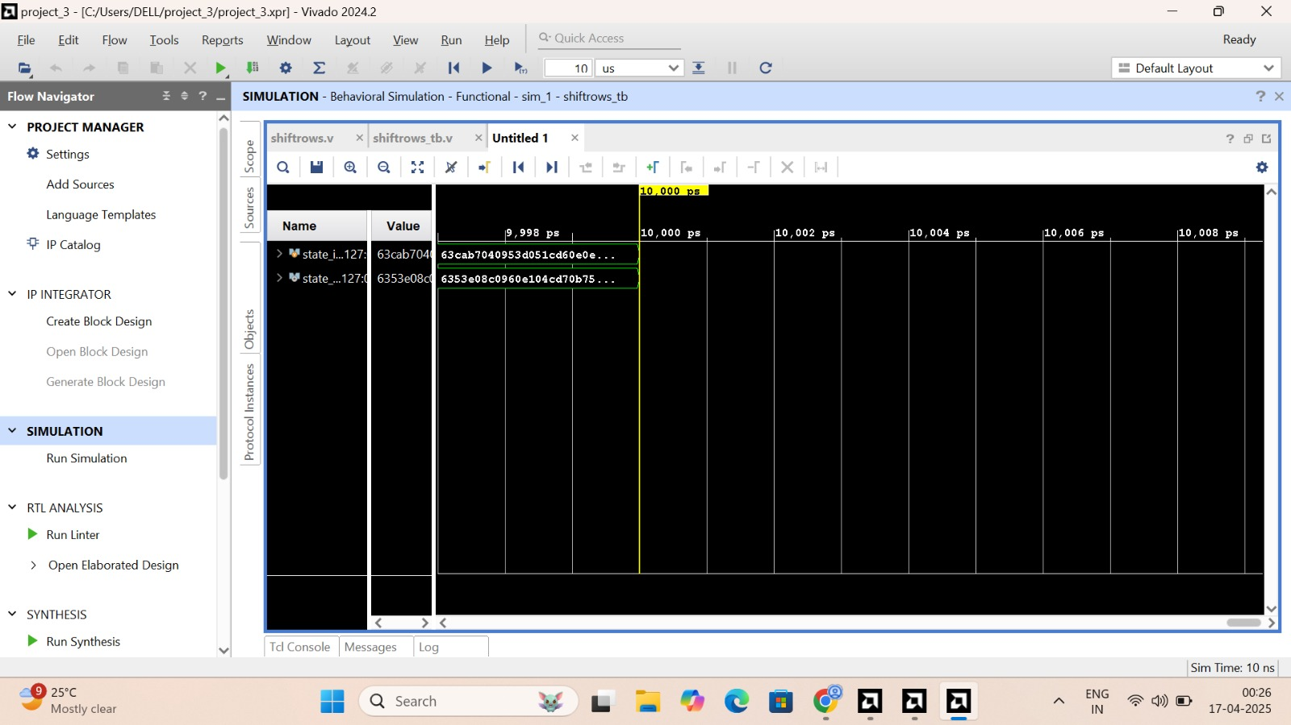
Simulation of Shift Rows Transformations
S

Slide 33
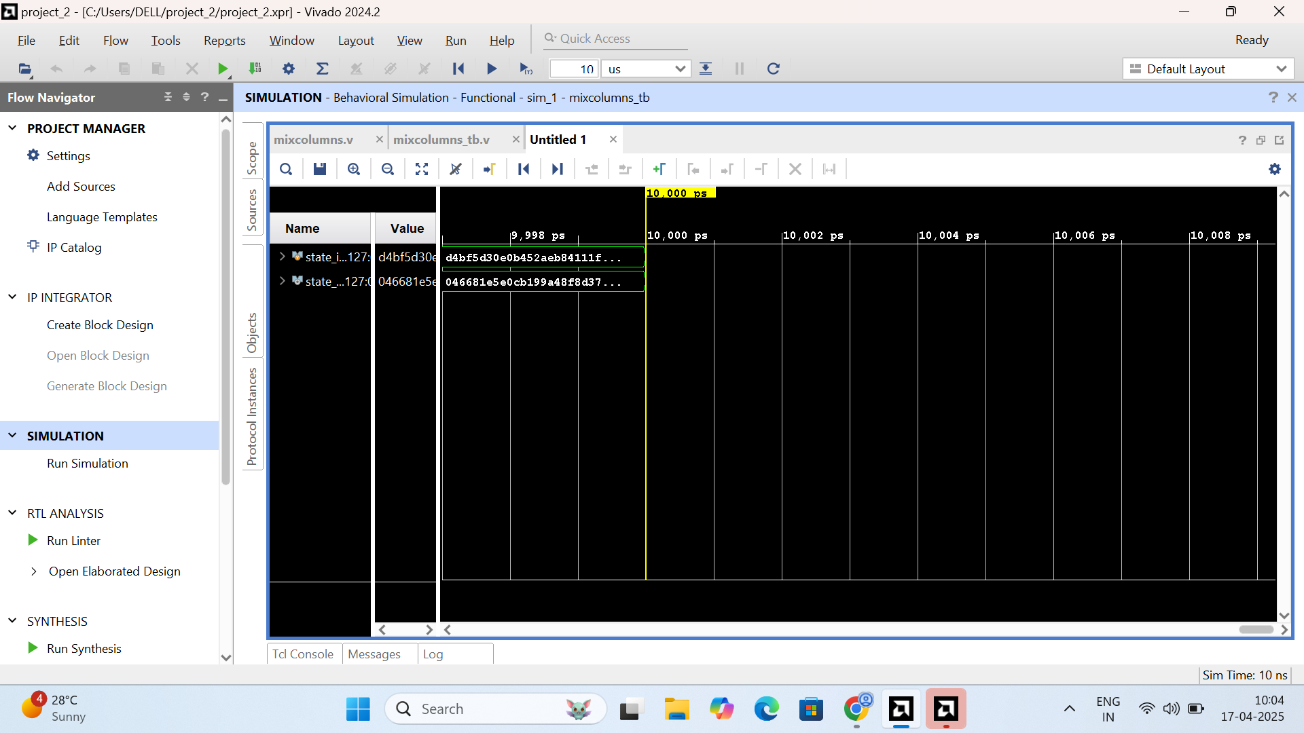
Simulation of Mixcolumns Transformation

Slide 34
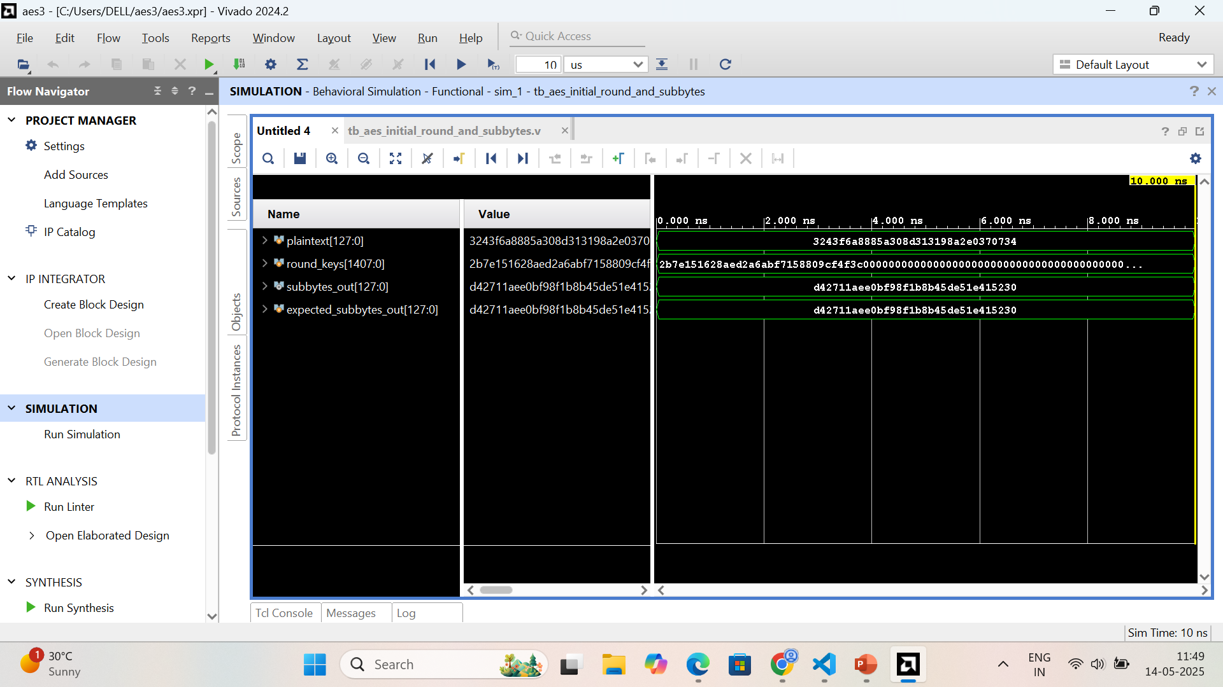
Simulation of Initial round and Subbytes

Slide 35
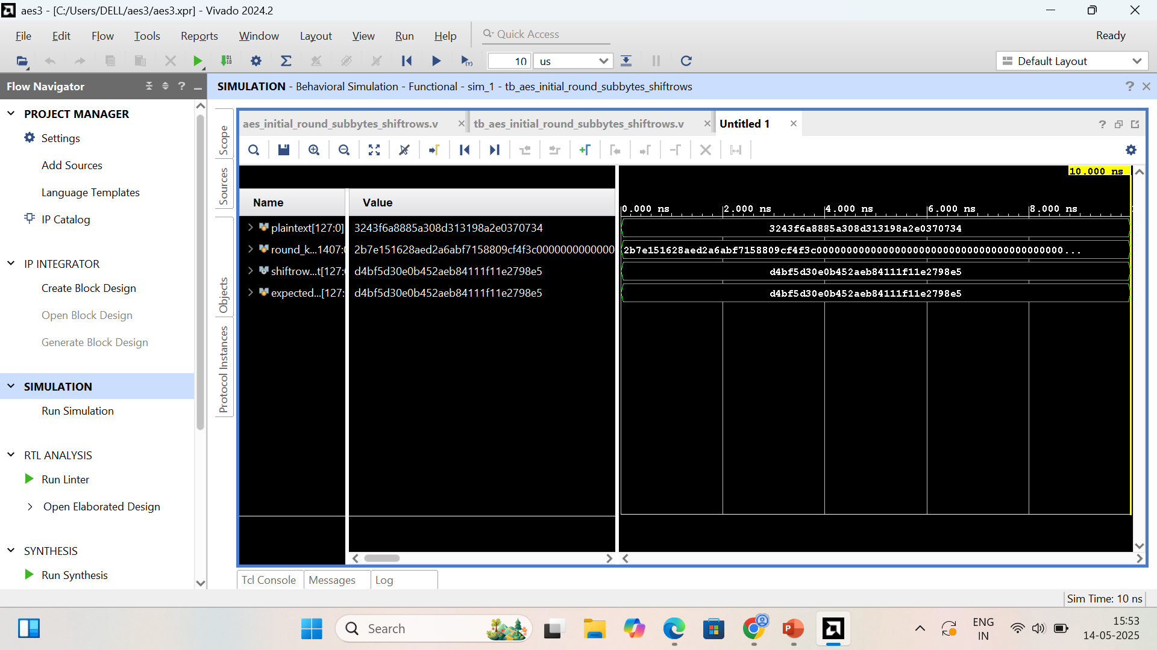
Simulation of Initial round, Subbytes and Shiftrows

Slide 36
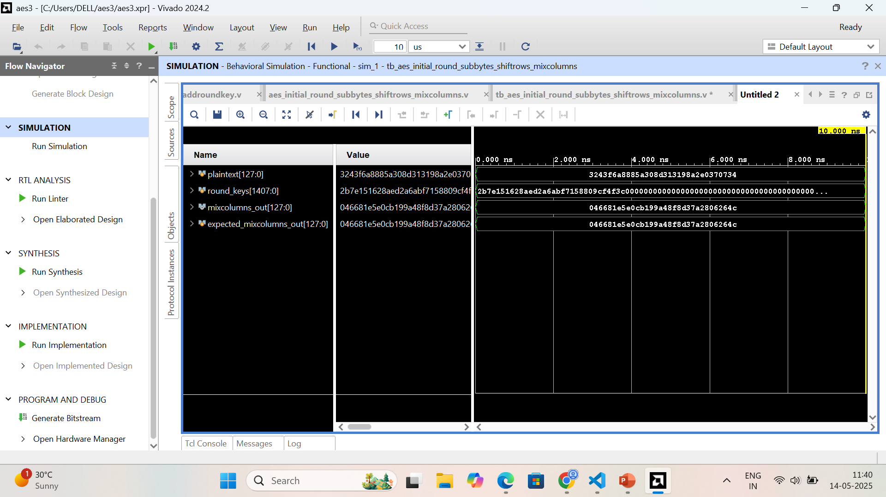
Simulation of Initial round, Subbytes , Shiftrows and Mixcolumns

Slide 37
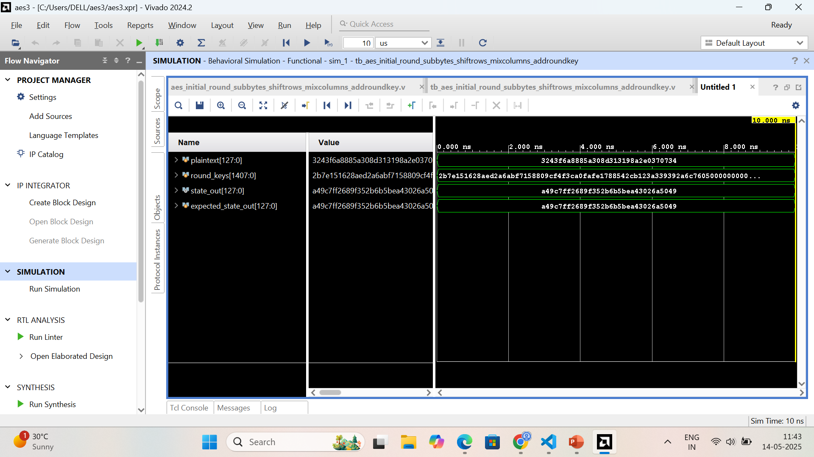
Simulation of Initial round, Subbytes , Shiftrows, Mixcolumns and Addroundkey

Slide 38
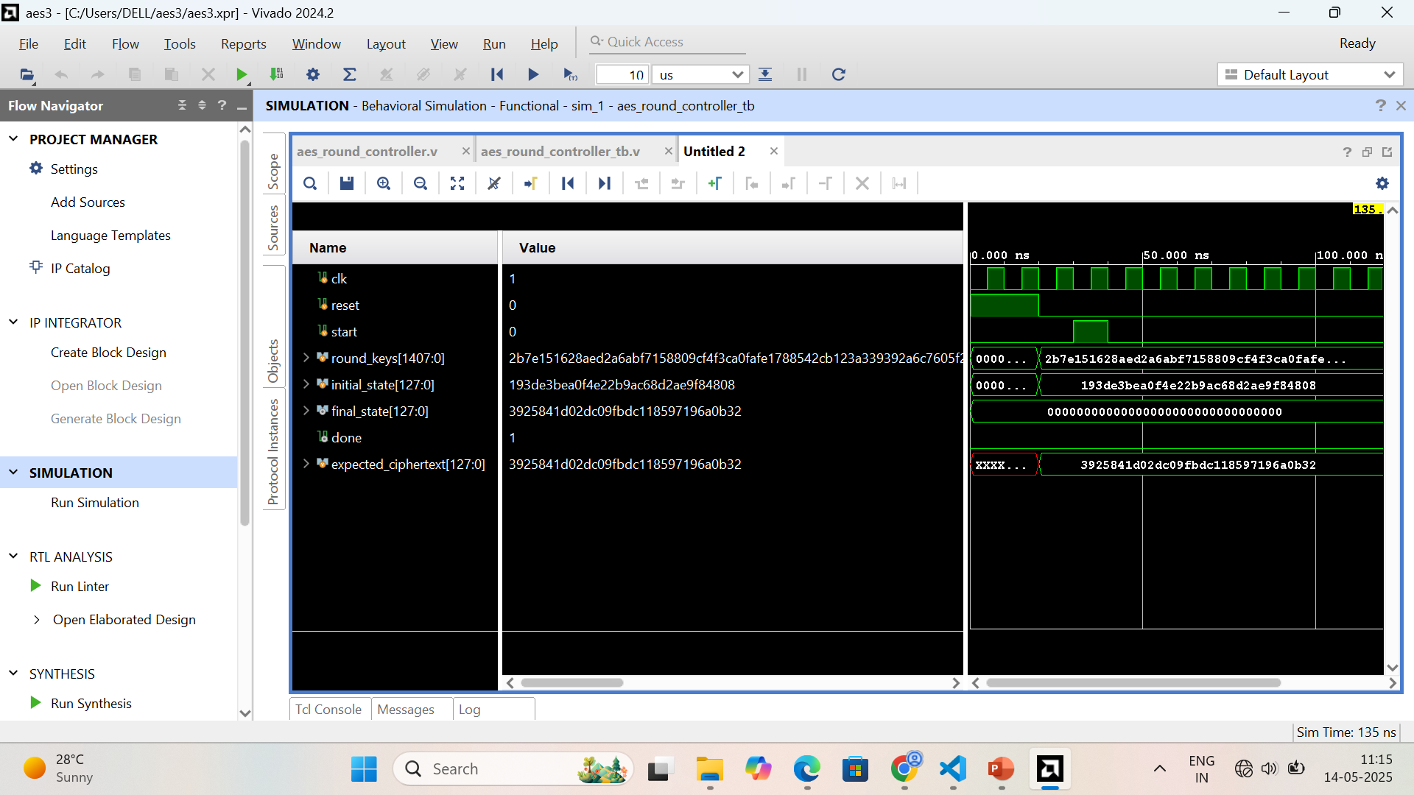
Simulation of AES Round Controller

Slide 39
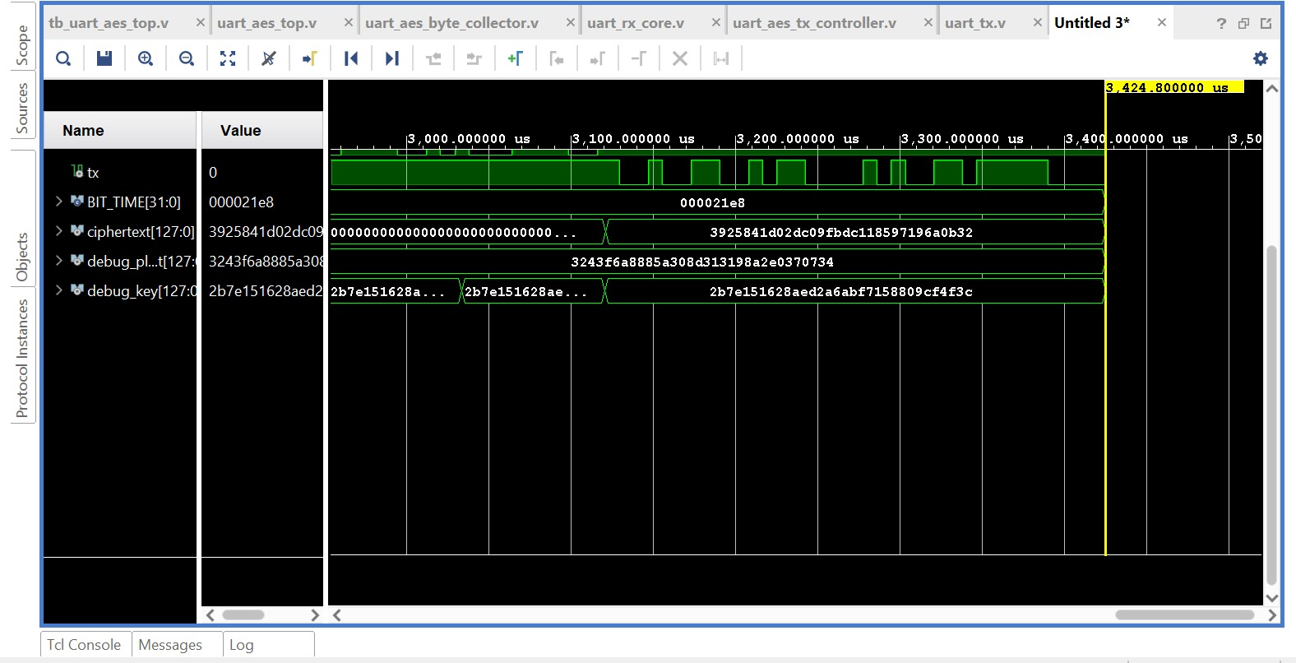
Simulation of AES Encryptor

Slide 40
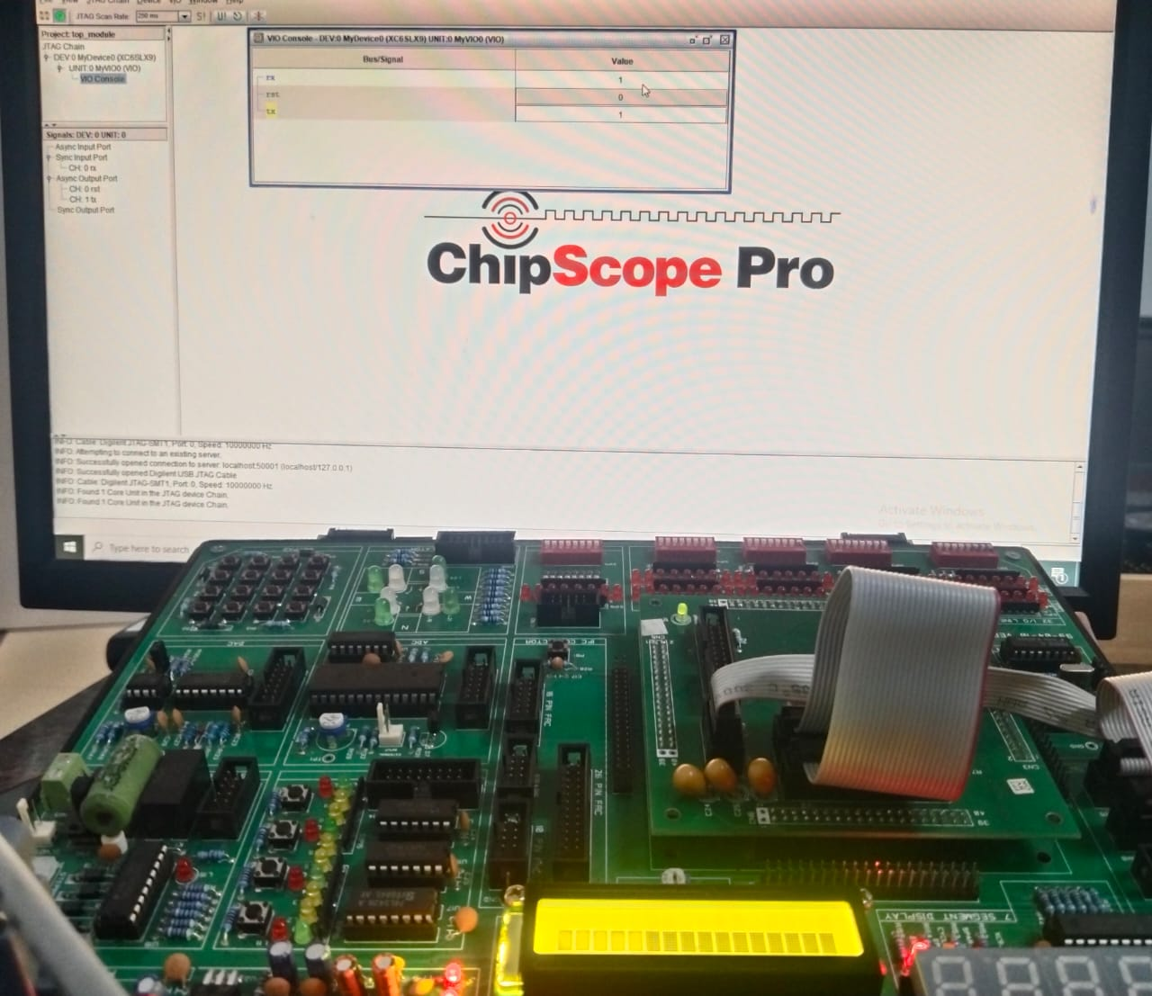
Implementation

Slide 41
Implementation details
AES was implemented successfully on a Spartan-6 FPGA, with verification and output observed virtually through Chipscope (Integrated Logic Analyzer – ILA). The design performed 128-bit encryption accurately, with the output ciphertexts matching the expected values, thereby confirming the functional correctness of the implementation. Resource usage remained within the tolerable limits of the Spartan-6 architecture, with efficient utilization of Look-Up Tables (LUTs), flip-flops (registers), and Block RAM (BRAM). The implementation operated reliably at a clock frequency of around 100 MHz, suitable for real-time cryptographic applications. Chipscope played a crucial role during the development phase by enabling real-time debugging and internal signal observation. It allowed designers to monitor key AES stages such as round transformations and key expansion, making the verification process more transparent and manageable. Overall, this project demonstrates that FPGA-based AES implementations are not only feasible but also highly secure, high-performance, and scalable, making them well-suited for embedded systems, data encryption modules, and secure communication applications.

Slide 42
Conclusion
The project successfully implemented AES-128 encryption on an FPGA with Verilog HDL, and it showed the viability of hardware-based encryption for secure and efficient data protection. The fundamental AES operations—SubBytes, ShiftRows, MixColumns, AddRoundKey, and Key Expansion—were correctly modeled and added to a working encryption pipeline. One of the most important components of the work was real-time analysis of the system with Chip- Scope, which validated by monitoring signals that data was properly encrypted, sent, and re- ceived successfully, thus ensuring overall functioning of the system. Utilizing the FPGA’s low- latency and parallel processing capabilities, the design was both high performance and secure in nature, hence applicable for real-time and resource-limited systems like embedded systems and IoT applications. This project also underscores the validity of AES-128 as a widely accepted and universally reliedupon encryption technique for secure data protection on digital systems
Future Scope
The modular design is scalable to AES-192 and AES-256, and facilitates the adaptability of the design to be integrated within more elaborate cryptographic systems. Improvements in the future can be made in the areas of power minimization, side-channel attack resistance, and dynamic key management to further extend its applicability within these embedded and IoT systems

Slide 43
REFERENCES
[1] “Advanced Encryption Standard, Federal Information Processing Standards 197”, National Institute of Standards and
Technology, November 2001.
[2] Abhiram.L.S, Gowrav.L, Punith Kumar.H.L, Sriroop.B.K,Manjunath C Lakkannavar, “Design and Synthesis of Dual
Key based AES Encryption”, IC2014 conference, MSRIT,2014.
[3] Marko Mali, Franc Novak and Anton Biasizzo “Hardware Implementation of AES Algorithm” –Journal of ELECTRICALENGINEERING, Vol. 56, No. 9-10, 2005, 265-269.
[4] Behrouz A. Forouzan and Debdeep Mukhopadhyay “Cryptography and Network Security” (2nd edition).

Slide 44
THANK YOU

